Slide 1
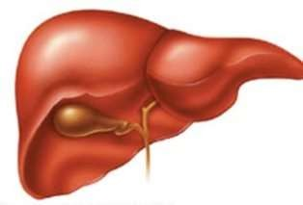
BIO-ARTIFICIAL LIVER

Slide 2
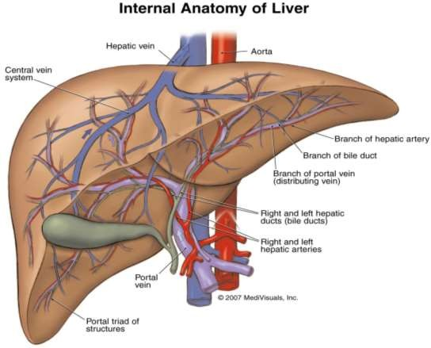
THE LIVER
Largest internal organ
Hepatic cells (hepatocytes) responsible for liver functions
Regenerative
Removing and excreting body wastes, hormones, Drugs, bacteria
Synthesizing plasma Proteins, bile, immune factors, helping the body fight infection
Storing certain vitamins, minerals, and sugars
Excretion of bilirubin.

Slide 3
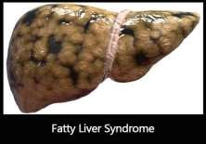
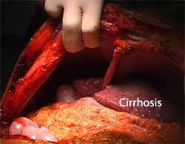
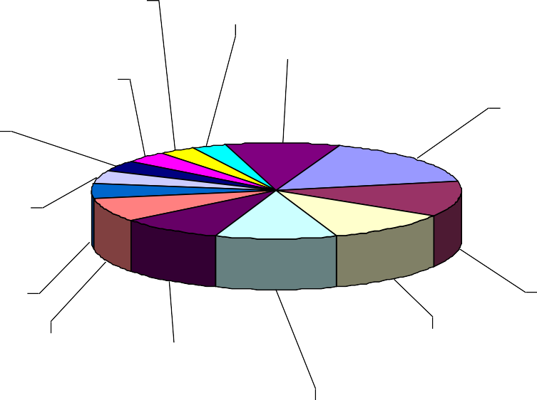
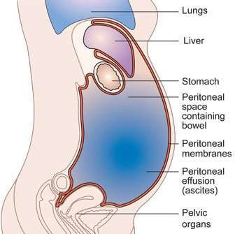
COMPLICATIONS
Recurrent bile duct infections
Cancer and drug damage
Alcohol damage
Cirrhosis
Fatty liver
Infected ascites
Reasons for Receiving Liver Transplant
^{Alpha antitrypsin} Fulminant liver failure
deficiency 3%
Budd-Chiari Syndrome 4%
3%
Other diseases 10%
Primary Biliary Cirrhosis
16%
Alcoholic Liver disease
4%
Cholangiocarcinoma 4%
Primary Sclerosing cholangitis
5%
Chronic Active Hepatitis
8%
Other cirrhosis (nonalcoholic) 12%
Biliary atresia 11%
Hepatocellular carcinoma 9%
Retransplantation 11%

Slide 4
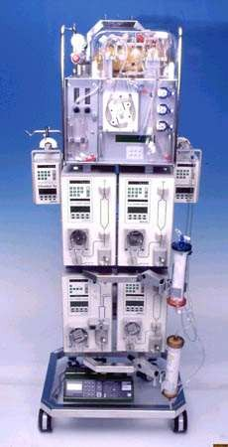
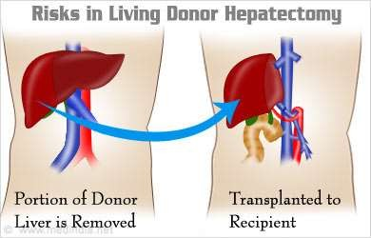
TREATMENTS
Liver Transplant
Most effective treatment for acute liver failure
High survival rates
Part of donor’s liver is transplanted to recipient
Bio-artificial Liver
Temporary fix
Keep the patient alive until
transplant is available
Liver regeneration
Stem cells are used to grow a new liver on the connective tissue and blood vessel scaffold of an old liver.

Slide 5
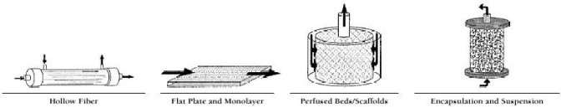
BIO ARITIFICIAL LIVER DEVICE
Viable and active cellular component
Cellular preparation must not transmit any infectious diseases
Can introduce the therapeutic and regulatory molecules
Blood must perfuse properly through system
Can filter substances from the blood
Immunocompatible

Slide 6
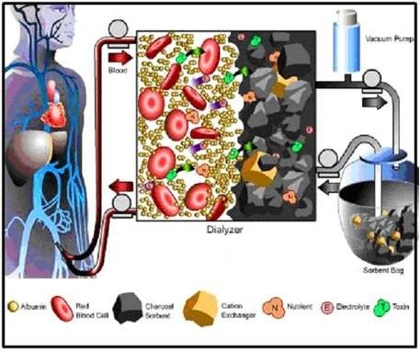
LIVER DIALYSIS UNIT
FDA approved in 1994.
Plate dialyzer with blood on one side, dialysate is a mixture of sorbents, activated charcoal being the essential component.
For a substance to be removed, must be dialyzable and able to bind to charcoal.
“Bridge to recovery” for treat acute hepatic encephalopathy and overdoses of drugs.
Post-market trials have shown the LDU to be effective in improving physiological and neurological status.

Slide 7
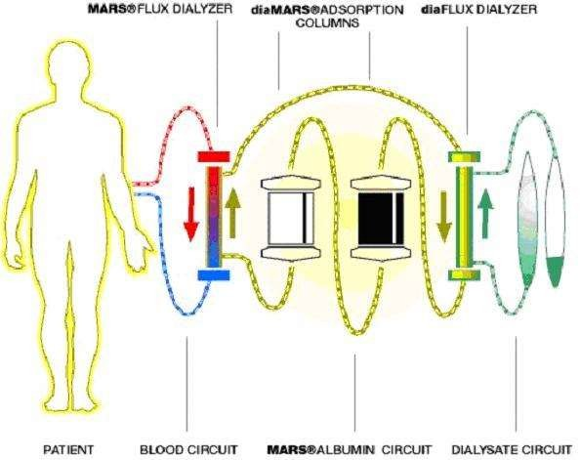
MARS® [Molecular Absorbent Recycling System ]
Limited to investigational use in US.
Hollow fiber membrane haemodialyzer.
Blood on one side, human albumin on other.
Albumin recycled through circuit containing another dialyzer & carbon and anion exchanger adsorption columns.
Removes both water-soluble &
protein bound substances.
Keep valuable proteins.
Trials have found it safe and associated with clinical improvement.

Slide 8
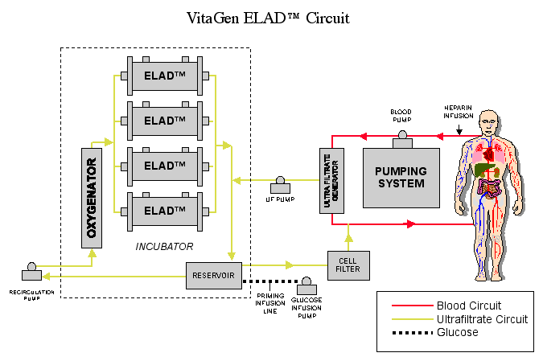
ELAD® [Extracorporeal Liver Assist Device ]
Uses cultured human hepatocytes express normal liver-specific metabolic pathways. hollow fiber dialyzer.
Dialyzer cartridge connected to continuous hemodialysis machines, like those used for renal therapy.
Blood separated into a cellular component and a plasma component.
Plasma through dialyzer, hepatocytes on outside of hollow fibers.
Currently involved in a phase 2 clinical trial to evaluate the safety
and efficiency.

Slide 9
BLSS [Bioartificial Liver Support System ]
Extracorporeal hemofiltration hollow fiber membrane
bioreactor with 100 grams of primary porcine hepatocytes.
Whole blood is filtered.
Contains blood pump, heat exchanger, oxygenator to control oxygenation and pH, and hollow fiber bioreactor.
Currently undergoing phase I/II clinical trials.
Patients show some improvement.

Slide 10
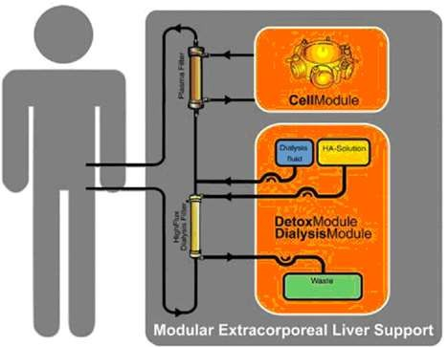
MELS [Modular Extracorporeal Liver System ]
Parallel plate design.
Human hepatocytes attached to semipermeable membranes on parallel plate.
Plasma separator, then plasma passes into the bioreactor.
In the bioreactor, the plasma flows over the semipermeable membrane where the hepatocytes are adhered.
Current trials in Europe
show promise.

Slide 11
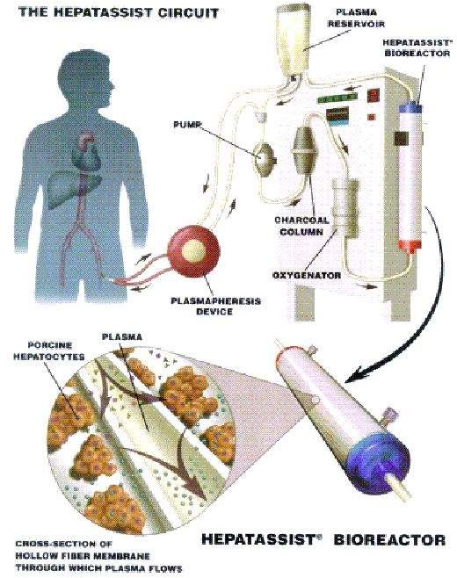
HEPASSIST 2000 SYSTEM
Four components: a hollow fiber bioreactor containing porcine hepatocytes, two charcoal filters, a membrane oxygenator, and a pump.
Must be used in conjunction with a commercially available plasma separation machine.
Blood separated; plasma processed through charcoal filters to remove particulates, bacteria, then enters bioreactor.
Hepatocytes must be heated and oxygenated.
FDA mandated full Phase III trials.

Slide 12
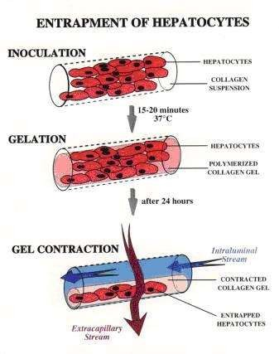
LIVERx2000
Hollow fiber cartridge.
Primary porcine hepatocytes suspended in a cold collagen solution and injected inside fibers.
Blood circulates outside the hollow fibers.
Designed to treat both acute and chronic liver failure.
Phase I/II clinical trials are underway to test the safety of efficacy of this device.
Anyone treated with the LIVERx2000 will be monitored for PERV.

Slide 13
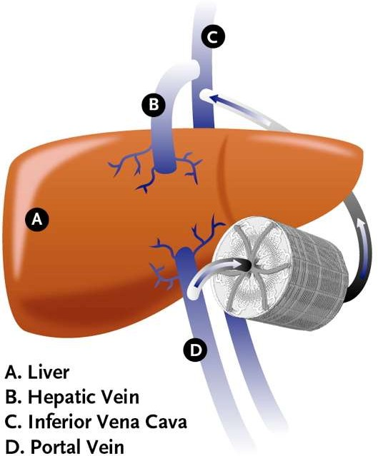
BIO ENGINES IMPLANTABLE DEVICE
Designed to take place in a liver or a portion of the liver.
Polymer grid-like mesh used as artificial vasculature resembling that of an actual liver.
Patterned silicon wafers serve as molds for polymer sheets.
Currently being tested on pigs.
Clotting issues.

Slide 14
AT PRESENT
Patients are in waiting list due to
Liver Transplant Statistics in 2019
unavailability of donor.
20000
18000
16000
14000
12000
10000
8000
6000
4000
2000
0
Use of immunosuppressants may
be needed.
These devices currently undergoing clinical trials.
Hepatocyte function can be
optimized.
Survival benefit has not been clearly demonstrated.
Clinical trials are for safety and
efficacy.
Patients
Transplants
Waiting List

Slide 15
FUTURE CHALLENGES
Research in cell sources/viability, Bioreactor design, Filtering techniques, Packaging for implantable devices.
Should provide at least 10% of liver functioning.
Controversy over the use of porcine cells due to possible transmission of infections.
Hepatocytes and plasma have very different physio-chemical properties.
Hepatocyte cells undergo a lot of stress inside of bio-artificial liver.
Limited volume of the bioreactor.
Proteins greater than pore size cannot be released.
To achieve density of cells needed to replace liver, an estimated 1000m of hollow fibers would be needed.
The risk of rejection is always present.

Slide 16
https://www.youtube.com/watch?v=wbh3SjzydnQ
https://www.youtube.com/watch?v=ufpGZV_zvLM
https://www.youtube.com/watch?v=bFLgr3G8ZQg

Slide 17
Artificial lung
The classic medical drama would be incomplete without the suspenseful mouth-to-mouth rescue scene, one person breathing for another to prolong life.
Hardly a ventilator device in itself, the concept still plays an essential role in current thoracic studies: develop a means of respiration, outside of an individual’s own power, that can assist or completely take over breathing for an impaired individual.
Currently in use is the mechanical ventilator with a wide variety of techniques, calculations and adjustments aimed at improving its success. On the horizon is the mechanical or artificial lung, a device that is implantable in a human for respiratory support.

Slide 18
The number of individuals requiring a lung transplant is on the rise. In acse of lung transplantation the number of lungs available, the demand clearly outweighs the supply.
Survival rate is 10 to 15% and the reason for this discrepancy was cited as “poor organ function,” leading to an even greater disparity between needed and available lungs.
Research has focused not merely on an artificial lung as a replacement organ, but rather an artificial lung as a bridge to transplantation.
Historically, artificial lung technology has been limited to its use in cardiopulmonary bypass and extracorporeal membrane oxygenation (ECMO). ECMO, however, has inherent complications.

Slide 19
It is very time-consuming, needing large amounts of monitoring and personnel, and the device itself consists of tubes and cannulae that can rupture and lead to fatal results.
ECMO therapy is nonambulatory and requires multiple transfusions; additional complications include infection, erythrocyte and platelet damage and embolization of tube fragments
The intravascular oxygenator, IVOX, is one such alternative. Gas enters and leaves the system via conduits outside a small skin incision. The device, a membrane oxygenator, is placed in the vena cava and a vacuum pump pulls oxygen through the device fibers

Slide 20
The cardiovascular system consists of heart and blood vessels and the blood
Sends blood to
Lungs for oxygen
Digestive system for nutrients
CV system also circulates waste products to certain organ systems for removal from the blood

Slide 21
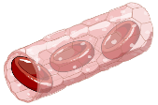
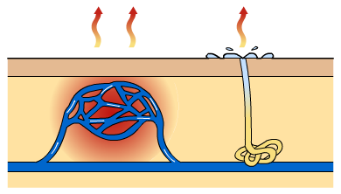
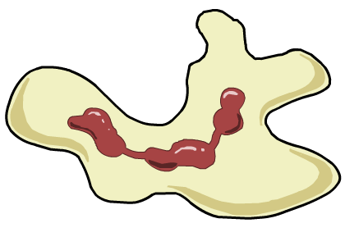
Functions of the circulatory system
The circulatory system has three functions:
1. Transporting substances around the body. These include oxygen, glucose, carbon dioxide, nutrients, water and waste products.
2. Controlling body temperature.
3. Protecting the body. Blood contains cells and anti-bodies that fight infection and clotting agents to stop bleeding.
The circulatory system is described as a double system because it has two loops.

Slide 22
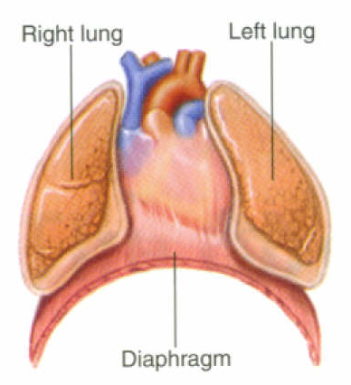
The Heart: Structures
Cone-shaped organ about the size of a loose fist
In the mediastinum
Extends from the level of the second rib to about the level of the sixth rib
Slightly left of the midline

Slide 23
The Heart: Blood Flow
Oxygenated blood out to body
Deoxygenated blood in from body
Oxygenated blood in lungs
Deoxygenated blood out to lungs
Atria Contract
Ventricles Contract

Slide 24

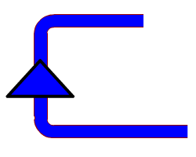

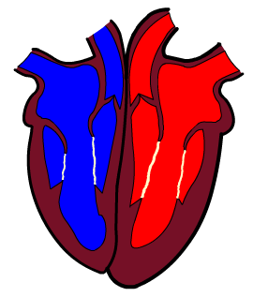
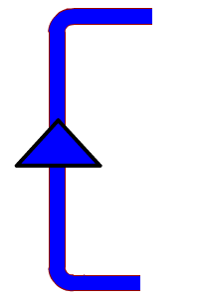
The circulatory system
Deoxygenated blood is pumped from the heart to the lungs through the pulmonary artery.
lungs
Oxygenated blood returns to the heart through the pulmonary vein.
Oxygenated blood is pumped at high pressure from the heart to the body through the aorta.
Deoxygenated blood returns to the heart through the vena cava.
body’s
cells
Notes:
This simple plan shows the heart and the 4 main blood vessels.
Introduce the following:
Double circulatory system = (1) PULMONARY CIRCULATION (anything pulmonary should be associated with the lungs) between the heart and the lungs and back (2) SYSTEMIC CIRCULATION between the heart and the rest of the body’s systems and back to the heart.
Introduce the idea of the heart as a double pump – the right-hand side receiving and pumping deoxygenated blood, the left-hand side receiving and pumping oxygenated blood.
ARTERIES carry blood away from the heart, VEINS carry blood to the heart.

Slide 25


The double circulatory system
The pulmonary circulation carries:
deoxygenated blood from the heart to the lungs
oxygenated blood back from the lungs to the heart, ready to be pumped out to the body.
lungs
The systemic circulation carries:
oxygenated blood to the rest of the body through the arteries
deoxygenated blood back to the heart through the veins.
body’s
cells
Notes:
Point out to students that the pulmonary vein is the only vein that carries oxygenated blood/ the pulmonary artery is the only artery that carries deoxygenated blood

Slide 26
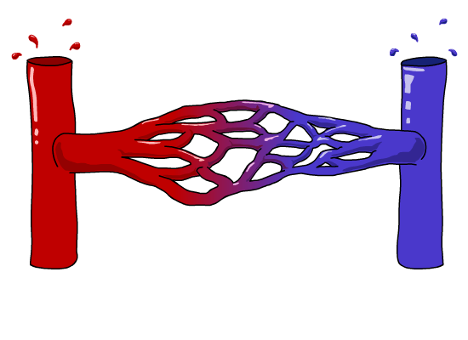


Blood vessels
There are three types of blood vessels, as shown in this magnified part of the circulatory system.
blood from the heart
blood to the heart
artery
vein
carries blood away from
the heart
carries blood back into
the heart
carries blood to and from the body’s cells
Why are there different types of blood vessels?
Notes:
There are different types of blood vessel because they perform different functions – arteries carry high pressure blood away from the heart, capillaries are small so that they can reach all of the body’s tissues and veins carry low pressure blood and therefore have valves. This is covered on the next slide.

Slide 27
Diseases and Disorders of the Cardiovascular System
Disease | Description
Anemia | The blood does not have enough red blood cells or hemoglobin to carry an adequate amount of oxygen to the body’s cells
Aneurysm | A ballooned, weakened arterial wall
Arrhythmias | Abnormal heart rhythms
Carditis | Inflammation of the heart
Endocarditis | Inflammation of the innermost lining of the heart, including valves

Slide 28
Diseases and Disorders of the Cardiovascular System (cont.)
Disease | Description
Myocarditis | Inflammation of the muscular layer of the heart
Pericarditis | Inflammation of the membranes that surround the heart (pericardium)
Congestive Heart Failure | Weakening of the heart over time; heart is unable to pump enough blood to meet body’s needs
Coronary Artery Disease (CAD) | Atherosclerosis; narrowing of coronary arteries caused by hardening of the fatty plaque deposits within the arteries

Slide 29
Diseases and Disorders of the Cardiovascular System (cont.)
Disease | Description
Hypertension | High blood pressure; consistent resting blood pressure equal to or greater than 140/90 mm Hg
Leukemia | Bone marrow produces a large number of abnormal WBCs
Murmurs | Abnormal heart sounds
Myocardial Infarction | Heart attack; damage to cardiac muscle due to a lack of blood supply

Slide 30
Diseases and Disorders of the Cardiovascular System (cont.)
Disease | Description
Sickle Cell Anemia | Abnormal hemoglobin causes RBCs to change to a sickle shape; abnormal cells stick in capillaries
Thalassemia | Inherited form of anemia; defective hemoglobin chain causes, small, pale, and short-lived RBCs
Thrombophlebitis | Blood clots and inflammation develops in a vein
Varicose Veins | Twisted, dilated veins

Slide 31
TOTAL ARTIFICIAL HEART
The era of total artiﬁcial heart replacement began in 1958 with the successful sustenance of circulation of a dog for 90 min by Akustu and Kolff (1958).
This was followed by the implantation of the Liotta heart by Cooley in 1969 and the Akutsu III heart in 1981 by Francis.
Both had unfavorable outcome.
It was in 1982 that the Jarvik-7 total artiﬁcial heart (TAH) was implanted in Barney Clark by DeVries and colleagues.
This operation attracted much public attention as a result of signiﬁcant coverage in the lay media. The New York Times went as far as calling this a ‘‘Dracula’’ of medical therapy.

Slide 32
An artificial heart is a prosthetic device that is implanted into the body to replace the function of original biological heart. It is distinct from a cardiac pump, which is an external device used to provide the functions of both the heart and the lungs.
Thus, the cardiac pump need not be connected to both blood circuits. A total artificial heart (TAH) is a device that replaces the two lower chambers of the heart. These chambers are called ventricles.
Heart failure is a condition in which the heart can't pump enough blood to meet the body's needs. "End stage" means the condition has become so severe that all treatments, except heart transplant, have failed.
(A heart transplant is surgery to remove a person's diseased heart and replace it with a healthy heart from a deceased donor.)

Slide 33
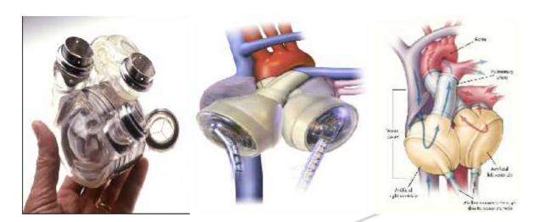
One of the best known devices is the "Jarvik-7" artificial heart, named for its designer Robert K. Jarvik, an American physician. Designed to function like the natural heart, the Jarvik-7 has two pumps (like the ventricles), each with a disk-shaped mechanism that pushes the blood from the inlet valve to the outlet valve

Slide 34
The action of the artificial heart is entirely similar to the action of the natural heart. There is, however, one huge difference: the natural heart is living muscle, while the artificial heart is plastic, aluminum, and Dacron polyester. As a result, the artificial heart needs some external source of "life."
An external power system energizes and regulates the pump through a system of compressed air tubes that enter the heart through the chest.
Since the system is cumbersome and open to infection, the use of an artificial heart is meant to be temporary.
Artificial hearts are typically used to bridge the time to heart transplantation, or to permanently replace the heart in case heart transplantation is impossible
Engineering design: Designing is the intellectual attempt to meet certain demands in the best possible way.
It is an engineering activity that imposes on nearly every sphere of human life, relies on the discoveries and laws of science, and creates the conditions for applying these laws to the manufacturer of useful products. The engineering design process can be divide into at least four stages:

Slide 35
Define the problem - clarification of the task.
1.1 Fit of the system – the device must first “fit” the patient. One must consider the volume and mass of the device, as well as any critical dimension such as the length, width, or height and the location of any tubes, channels or connectors.
The device should not project heat in such a way that surface in contact with tissue or blood are subjected to a temperature rise 5⁰C above core temp. on a chronic basis. The effect of device movement and vibration should be considered in the design specification.
The acceptable sound levels at various frequencies must be specific. A device should meet existing standards for electromagnetic interference and susceptibility.

Slide 36
1.2 Pump performance –pump performance must be specified in terms of cardiac output range.
A heart assist or total artificial heart device must be able to pump a cardiac output ranging up to 8 litres/min with physiologic inlet and outlet artery pressure.
1.3 Biocompatibility- the device must not cause excessive damage to the biologic system. Specifically, the device must be minimally thrombogenic and haemolytic It should have a minimal effect on the immune system.
It should not promote infection, calcification, or tissue necrosis.

Slide 37
1.4 Reliability- the design specification must assign a target reliability for the device. The design specification must state which components of the system could be changed if necessary.
The reliability issue is very complex and involves moral, ethical, legal and scientific issues.
1.5 Quality of life-the design specification must address the quality of life for the patient.
2. Conceptual design – plan treatment
3. Detailed design – execute the plan 4. Learn and generalize – finally, after the design is complete, the designer should be able to learn and generalize from the design. This educational process will include manufacturing of prototypes and testing. General concepts and principles may be gleaned from the design process that can be applied to further designs.

Slide 38
Circulatory assist devices were initially designed to support patients in hemodynamic collapse, But are now used for a wide range of clinical conditions ranging from prophylactic insertion for invasive procedures to cardiogenic shock or cardiopulmonary arrest.
There are three major types of percutaneous devices (as well as surgically-implanted ventricular assist devices):
Counterpulsation devices (intraaortic balloon pump [IABP] and noninvasive counterpulsation)
Cardiopulmonary assist devices (Cardiopulmonary support or CPS)
Left ventricular assist devices (eg, Impella)

Slide 39
An intra-aortic balloon pump (IABP) is a mechanical device that is inserted into the aorta, the body's largest artery. It is a long, thin tube called a catheter with a balloon on the end of it.
It is used to assist the heart to pump more blood around the body and also improves the delivery of oxygen to the heart.
The IABP is the most commonly used mechanical support device. It has a long clinical record of success, is simple, is inserted easily and rapidly, is the least expensive of all the devices, and does not require constant monitoring by technical support personnel.

Slide 40
Working of IABP The IABP is connected to a long catheter (tube) that is inserted via the groin using a small incision made under local anaesthetic.
The catheter is then carefully guided up a large blood vessel until it is near the heart. The IABP machine is synchronised to the patient’s heart rhythm and pumps gas into a balloon at the end of this catheter.
This balloon rhythmically inflates and deflates pushing blood forward around the body and also pushes blood back into the coronary arteries of the heart.
In this way both the body and the heart get improved blood circulation and oxygen delivery.

Slide 41
Counterpulsation is a term that describes balloon inflation in diastole and deflation in early systole.
Balloon inflation causes ‘volume displacement’ of blood within the aorta, both proximally and distally. This leads to a potential increase in coronary blood flow and potential improvements in systemic perfusion by augmentation of the intrinsic ‘Windkessel effect’, whereby potential energy stored in the aortic root during systole is converted to kinetic energy with the elastic recoil of the aortic root.

Slide 42
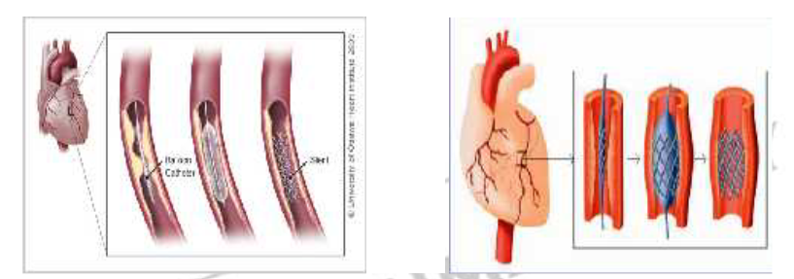
Stent: A stent is a small mesh tube that's used to treat narrow or weak arteries. Arteries are blood vessels that carry blood away from heart to other parts of the body. A stent is placed in an artery as part of a procedure called percutaneous coronary intervention
(PCI), sometimes referred to as coronary angioplasty (AN-jee-oh-plas-tee). PCI restores
blood flow through narrow or blocked arteries. A stent helps support the inner wall of the artery in the months or years after PCI.
Doctors also may place stents in weak arteries to improve blood flow and help prevent the arteries from bursting. Stents usually are made of metal mesh, but sometimes they're made of fabric. Fabric stents, also called stent grafts, are used in larger arteries. Some stents are coated with medicine that is slowly and continuously released into the artery. These stents are called drug-eluting stents. The medicine helps prevent the artery from becoming blocked again.

Slide 43
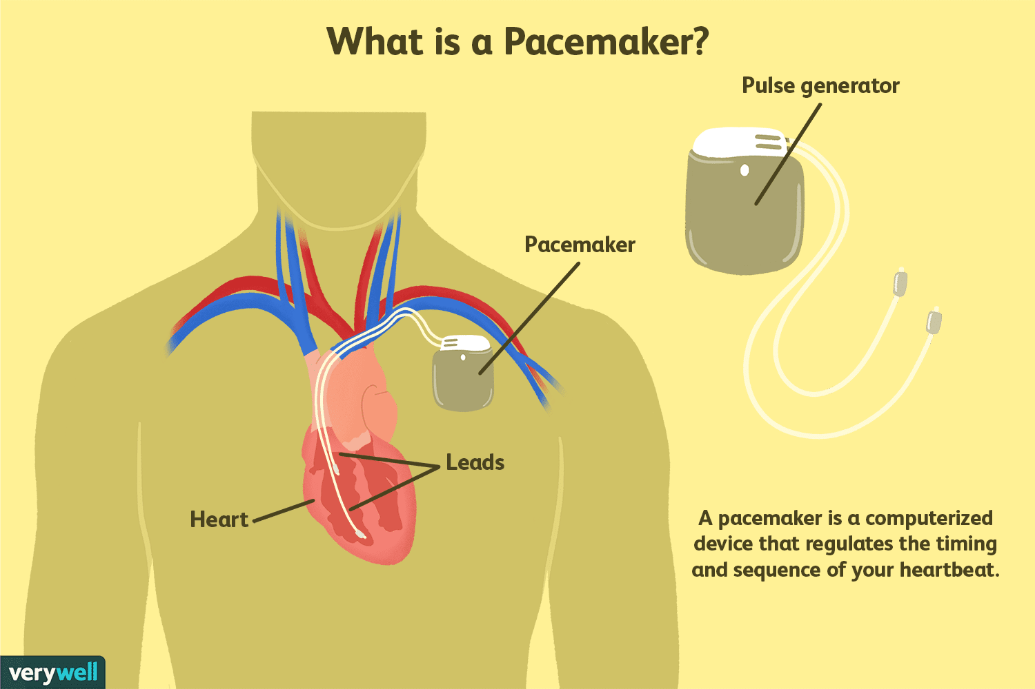
Pace makers: A pacemaker is a small device that is implanted under the skin in the chest to help the heart beat the way that it should. Pacemakers send electrical signals to the heart to make sure that heart rate is never too slow.
https://www.youtube.com/watch?v=SMXBR_YFocs

Slide 44
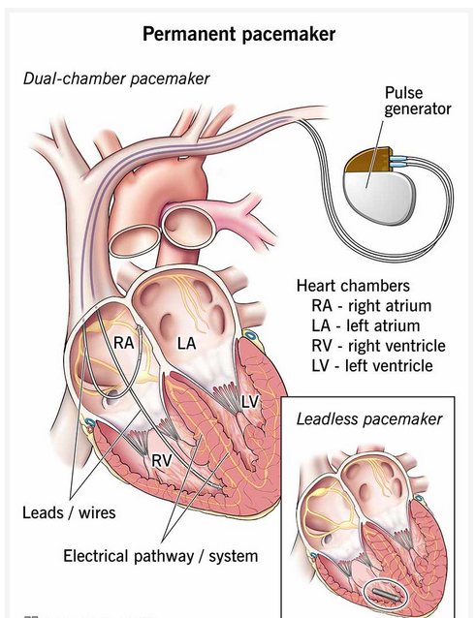
Pacemakers are devices that can be placed in your body, usually by surgery, to support the electrical system in your heart. They can stabilize abnormal heart rhythms and prevent problems that can disrupt or endanger your life.
How do pacemakers work?
Your heart has its own electrical system, which tells your heart’s chambers when it’s their turn to squeeze. When your heart’s electrical system malfunctions, your heart’s chambers may squeeze in the wrong order or squeeze too weakly to provide enough blood to your body. Pacemakers use electrical impulses to correct these kinds of malfunctions.
What conditions do pacemakers treat?
Conditions that are treatable with a pacemaker include (but aren’t limited to):
Certain heart arrhythmias (malfunctions of your heart’s normal beating process).
Disruptions of your heart’s electrical system (such as heart blocks).
Heart failure.
History of heart attack.

Slide 45
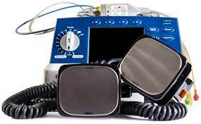
Defibrillator:
A defibrillator is a device that provides an electric shock to your heart to allow it to get out of a potentially fatal abnormal heart rhythm, or arrhythmia, — ventricular tachycardia (with no pulse) or ventricular fibrillation — and back to a normal rhythm.
Defibrillators are devices that apply an electric charge or current to the heart to restore a normal heartbeat. If the heart rhythm stops due to cardiac arrest, also known as sudden cardiac arrest (SCA), a defibrillator may help it start beating again. A sudden cardiac arrest is fatal unless treated right away with CPR (cardiopulmonary resuscitation) and a defibrillator.
https://www.youtube.com/watch?v=3il0ii7Svwk
https://www.youtube.com/watch?v=hxTxROuUj4g

Slide 46
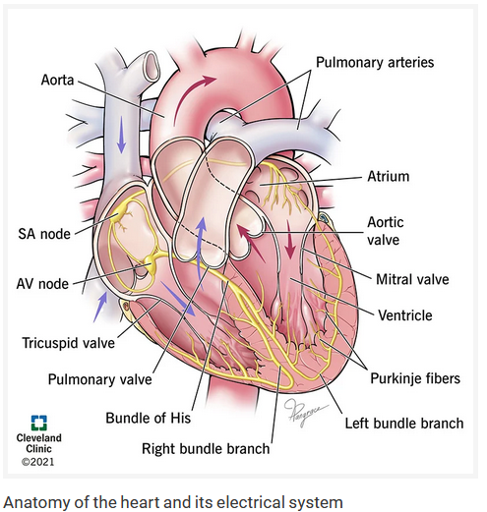
The human heart is an engine that has to work 24/7 to keep you alive, and it has to be reliable and effective. To do this, it relies on a specialized network of cells called the cardiac conduction system. It’s also known as your heart’s electrical system.
Cells in the cardiac conduction system can generate electrical impulses and then distribute the signal throughout your heart. While all cells in your heart can conduct electricity, the cells in this system conduct it at very specific speeds. This is how different parts of your heart beat at just the right time. The parts of the cardiac conduction system are (in order, starting where electricity is generated):
The sinoatrial (SA) node.
The atrioventricular (AV) node.
The Bundle of His.
Bundle branches.
Purkinje fibers.

Slide 47
Artificial blood:
Artificial blood can be defined as a liquid that can carry large amounts of oxygen and can
serve as a temporary substitute for blood. Artificial blood also called “blood substitutes” that are used to fill fluid volume and/or carry oxygen and other gases in the cardiovascular
system.
Blood substitutes can be divided into two categories:
A. Volume expanders: inert and merely increase blood volume. These may be crystalloid-
based (Ringer's lactate, normal saline, D5W (dextrose 5% in water)) or colloid-based
(Haemaccel, Gelofusin).
B. Oxygen therapeutics: mimic human blood's oxygen transport ability. Examples:
Hemopure, Oxygent, PolyHeme.

Slide 52
Artificial Pancreas (Biopancreas):
The artificial pancreas is a technology developed to help diabetic people. It automatically controls blood glucose level by providing the substitute endocrine functionality of a healthy pancreas.
There are several important exocrine (digestive) and endocrine (hormonal) functions of the pancreas, but it is the lack of insulin production, which is the motivation to develop a substitute for pancreas.

Slide 53
Artificial Pancreas:
Long standing diabetes mellitus (types I and II) results due to the inability of the pancreas to secrete insulin.
Therapy has been focused at administering the insulin exogenously to achieve acceptable blood sugar levels, however, it is often difﬁcult to manage.
Transplantation of the isolated islet cells (which secrete insulin) although promising is limited due to the associated need for immunosuppression and limited organ supply.
Devices such as microencapsulated islets (small diameter spherical chamber, including hollow ﬁber, disk-shaped diffusion chambers and Millipore cellulose membranes) have been proposed

Slide 54
Advancements in glucose sensing and insulin sensing technology have allowed developing automated closed loop insulin delivery systems that can deliver insulin in a more physiologic way.
One such system currently undergoing clinical trials is a diffusion chamber for a bio-artiﬁcial endocrine pancreas (Bio-AEP), which is constructed by placing pancreatic islet cells, trapped in a scaffold; this is sandwiched between semipermeable membranes, and shielded by silicone .
Although some of the results achieved in animal studies have been difﬁcult to reproduce in large animal models, this therapy holds promise for the future treatment of diabetes mellitus

Slide 55
Different approaches (Different insulin administration systems of artificial pancreas) under consideration include:
The medical equipment approach (Insulin pump) -- using an insulin pump under closed loop control & real-time data from a continuous blood glucose sensor.
The bioengineering approach (The Bio-artificial pancreas): -- the development of a bio-artificial pancreas consisting of a biocompatible sheet of encapsulated beta cells. When surgically implanted, the islet sheet will behave as the endocrine pancreas and will be viable for years.
The gene therapy approach -- the therapeutic infection of a diabetic person by a genetically engineered virus which causes a DNA change of intestinal cells to become insulin-producing cells

Slide 56
Bio-artificial pancreas:
This involves harvesting insulin-producing cells from pigs, encapsulating the cells in dissolvable “microreactors” (a tiny, dissolvable, spherical cage) and then injecting them into the abdomens of people with diabetes.
The microreactors float freely and producing insulin as needed. This is a living drug-delivery system where pancreatic cells have a biochemical mechanism that continuously monitors blood glucose, releasing only enough insulin to keep blood sugar within a normal range.
The microreactors permit life-sustaining oxygen and nutrients to flow in and wastes and insulin to flow out, keeping cells healthy and nourished.

Slide 57
Capillary Bio-artificial Pancreas (Extracorporeal artificial pancreas): In extracapillary space, pancreatic cells are being cultured.
The pancreatic cells are islet of Langerhans, which secrets hormone insulin and assimilate glucose.
Glucose rich blood in diabetes patient are passed through the capillaries (made of silicone rubber, Teflon, Dacron, etc.).
Glucose from the blood diffuses through the membrane to the extracapillary site and insulin is released from pancreatic cells and also passes through the membrane into the intracapillary site.
Insulin converts the glucose into glucagons and ultimately, glucose level in blood decreases by a significant level. The blood is circulated through capillary till the desired level of glucose in blood is achieved.

Slide 58
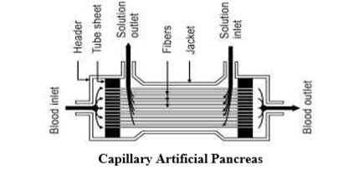

Slide 59
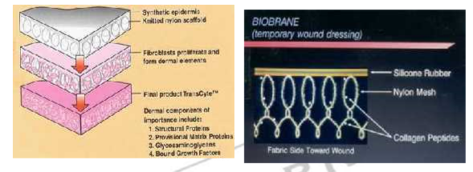
Artificial skin
Artificial skin is a synthetic covering with two layers for regeneration of skin and is used to treat burn victims. The material contains microcapsules filled with a special healing agent. Like human skin, it bleeds and heals itself, offering a potential breakthrough in vital materials used in surgical implants.

Slide 60
ARTIFICIAL SKIN
Successful application of skin substitutes has been applied widely in the clinical ﬁeld for a few decades now.
The development of skin substitutes or artiﬁcial skin began with growing sheets of cells in culture media and has progressed to developing complex structures with bi-layered skin that mimics the human skin.
A deeper dermal element is constructed using synthetic epidermis.
Currently there are three approaches used for manufacturing artiﬁcial skin,
The gel approach where cells are grown in a gel of extracellular material like collagen.
The scaffold approach where porous scaffolds created from collagen or synthetic material are used to allow cells to be seeded subsequently

Slide 61
The third approach entails, self-assembly, it is still in animal testing stage and has to await clinical application.
Some of the artiﬁcial skin substitutes available are, Alloderm1 introduced in market in 1992 and is based on treating fresh cadaver skin in which the epidermal layer is removed and cellular components are destroyed .
The freeze drying of this skin substitute renders it immunologically inert and hence is not rejected by the recipient
Its approved in 1996 by FDA is another skin substitute available commercially and is made from cellular collagen and glycosaminoglycans matrix .
The dermal component is made of collagen and the epidermal element is substituted by synthetic silicon.

Slide 62
Dermagraft1 is an allogenic dermal substitute, it comprises of a scaffold of polyglactin seeded with allogenic ﬁbroblasts. This is now used to treat skin ulcers and burn wounds.
Another allogenic frozen dermal substitute is TransCyte1, which is used as a temporary replacement for wounds and burns.
It is created by seeding ﬁbroblasts into a scaffold made from nylon mesh and silicone sheet.
Bilayered substitutes are composed of allogenic keratinocytes seeded on a nonporous collagen gel and covered with a bovine collagen scaffold containing ﬁbroblasts (OrCel1) and offer more biologically mimicking skin substitute.

Slide 63
Trancyte is a bilayer skin substitute.
Outer epidermal analog is a thin nonporous silicone film with barrier functions. Inner dermal analog is layered human fibroblast products mainly collagen type 1,fibronectin and Glycosaminoglycan.
Subsequent cryo-preservation destroys fibroblasts but preserves activity of fibroblast-derived products.
Thin water layer at surface is maintained for epidermal cell migration.
It is removed after re-epithelialization (or prior to skin graft or excised wound).
Silicone provides flexibility. It must be kept frozen until use

Slide 64
Biobrane is a bilayer synthetic skin substitute.
Outer epidermal analog constructed of a thin silicone film with barrier functions comparable to skin.
Small pores present in silicone to allow for exudates removal, permeability to topical antibiotics. Inner dermal analog composed of a three dimensional irregular nylon filament weave upon which is bonded type I collagen peptides
Surface binding of inner membrane potentiated by collagen-fibrin bonds as well as fibrin deposition between nylon weave.

Slide 65
Subsequently fibronectin, produced by migrated fibroblasts, enhances binding to the fibrin entrapped in mesh .
New epithelial cells growing along mesh measures adherence.
Thin water layer at surface maintained for epidermal cell migration
. Removed after re-epithelialization (or prior to skin graft on excised wound)
Silicone and nylon weave provides flexibility.

Slide 66
Artificial blood: Artificial blood can be defined as a liquid that can carry large amounts of oxygen and can serve as a temporary substitute for blood.
Artificial blood also called “blood substitutes” that are used to fill fluid volume and/or carry oxygen and other gases in the cardiovascular system.
Blood substitutes can be divided into two categories: A. Volume expanders: inert and merely increase blood volume. These may be crystalloid based (Ringer's lactate, normal saline, D5W (dextrose 5% in water)) or colloid-based (Haemaccel, Gelofusin). B. Oxygen therapeutics: mimic human blood's oxygen transport ability. Examples: Hemopure, Oxygent, PolyHeme

Slide 67
ARTIFICIAL BLOOD
Inadequate oxygen delivery to the tissues is common when signiﬁcant blood loss occurs due to trauma or surgery. This is commonly treated in clinical practice by administering donated human blood. However, the availability of donors and the risk of transmission of infections limit this approach. Fatal reactions can occur due to a mismatch or presence of antibodies in the blood of the recipient; in addition, repeated blood transfusions can depress the immune function in the host. This is one of the reasons why an artiﬁcial blood substitute is highly desirable since it can avoid these complications. Two main approaches are used for achieving an artiﬁcial blood substitute, bioartiﬁcial oxygen carriers and totally synthetic oxygen carriers. Bio-artiﬁcial oxygen carriers are hemoglobin-based oxygen carriers and use human, animal, or recombinant hemoglobin

Slide 68
Synthetic oxygen carriers use metal chelates that mimic the hemoglobin’s oxygen binding capacity. Artiﬁcial ﬂuorinated organic compounds can physically dissolve large amounts of oxygen, perﬂurocarbon based oxygen carriers are commonly employed for this purpose.
However, in a strict sense they constitute oxygen carrier substitutes and not blood substitutes since they lack the coagulation factors and immune cells ﬁghting infection that are essential in aiding coagulation and clot formation and ﬁghting infection, which can be vital in the patients receiving these therapies. Examples of bio-artiﬁcial oxygen carriers include modiﬁed human or animal hemoglobin-based carriers, stabilized hemoglobin tetramers, polymerized hemoglobin, conjugated hemoglobin, and liposome encapsulated hemoglobin. Other carriers also include recombinant hemoglobin or from transgenic studies. Synthetic oxygen carriers include lipid–heme vesicles, hemoglobin aquasoms, and perﬂuro carbon based carriers.

